Slide 1










Easydiner Webscrapping
Analysis
Get to know more about What type of restaurants in major cities .

Slide 2



Introduction
This Project focuses on EXPLORATORY DATA ANALYSIS (EDA) to understand ,clean and analyze the dataset .
Using PUTHON (NumPy , Pandas , Matplotlib , Seaborn) ,we explored
Both numerical and categorical features of the dataset .
The analysis includes Data cleaning , Handling missing values , Outlier detection and feature exploration .
After EDA , the result were integrated into Power BI Desktop to design
An interactive Dashboard for data visualization .

Slide 3
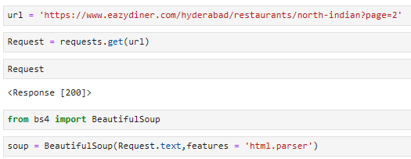

Getting Response from website
Fetched the webpage successfully using requests .
Parsed HTML content with BeautifulSoup .

Slide 4

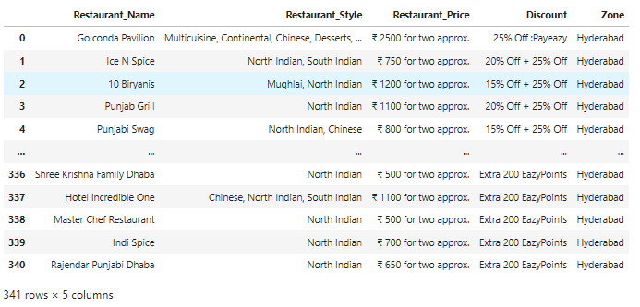
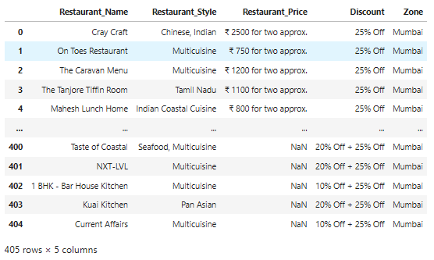
Scraping Data From website
I selected these seven cities from the website for data scraping :
Hyderabad , Mumbai , Vishakapatnam , Bengaluru , Chennai , Pune and Goa.
Hyderabad
Mumbai

Slide 5
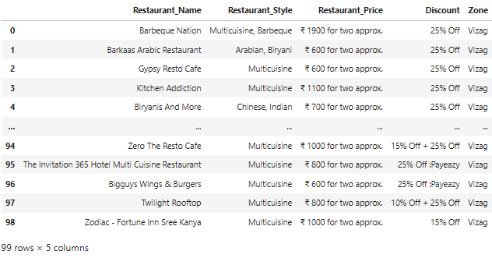
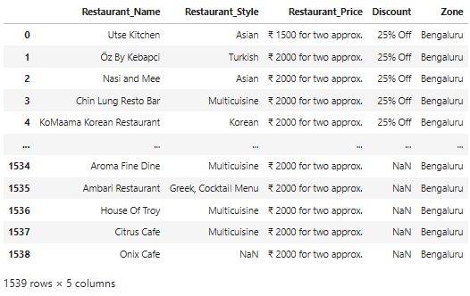
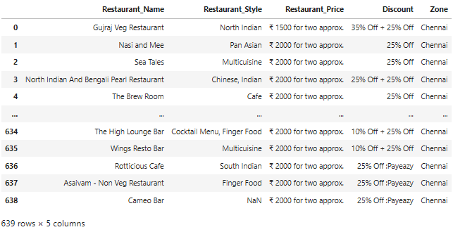
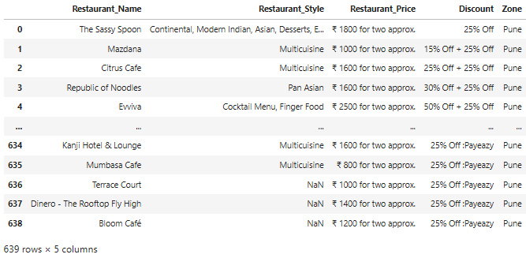
Vishakapatnam
Bengaluru
Chennai
Pune

Slide 6
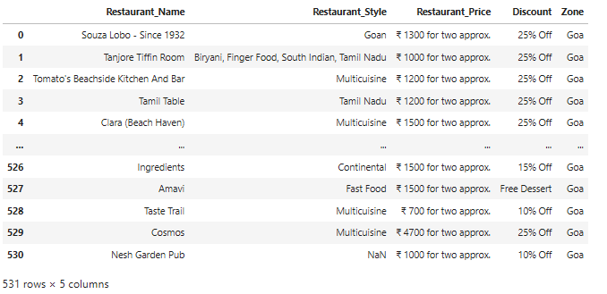
Goa
Total number of entries collect from webiste
Hyderabad - 341 restaurants
Mumbai - 405 restaurants
Vishakapatnam - 99 restaurants
Bengaluru - 1539 restaurants
Chennai - 639 restaurants
Pune - 639 restaurants
Goa - 531 restaurants

Slide 7
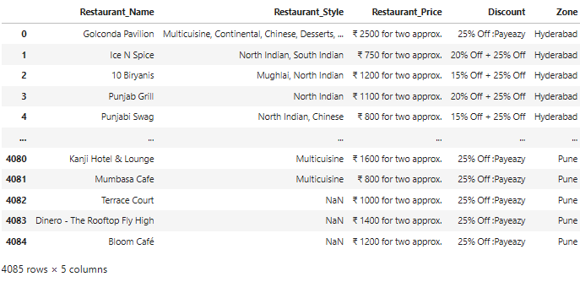
After combining all DataFrames into One DataFrame
Easydiner - 4085 restaurants
EASYDINER

Slide 8
Data Cleaning
After performing web scraping, I compiled a dataset containing 4085 restaurants records , each described by 5 distinct columns.
COLUMNS
Unnamed - Unknown Column.
Restaurant Name - Displays the name of the restaurant .
Restaurant Style - Indicates the cuisine or style of the restaurant .
Restaurant Price - Represents the price range of the restaurant .
Discount - Shows available discounts offered by the restaurant .
Zone - Specifies the region / location of the restaurant .

Slide 9
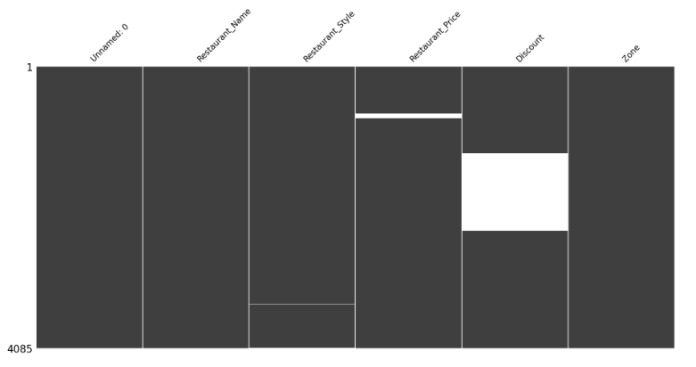
Checking duplicates in all columns :
Checking duplicates in all columns .
There is no duplicates are in columns .
Checking nulls in all columns :

Slide 10
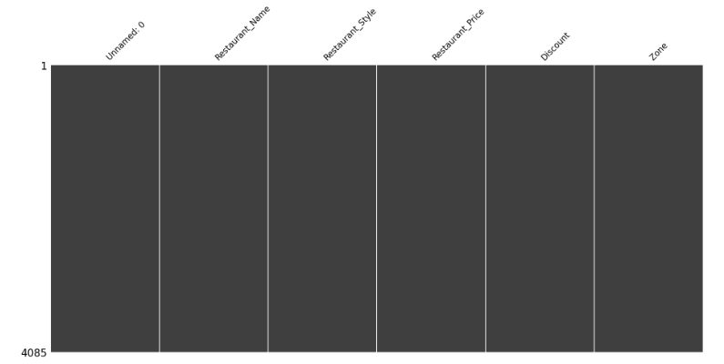
Filling all nulls with (---) in all columns :

Slide 11

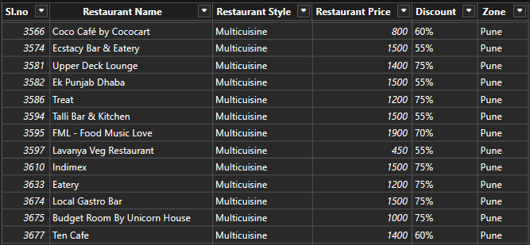

Data Visualization
“ After handling all null values in the dataset , Since all columns are categorical , I decided to transform the data using Power BI Desktop and create visualizations.”
“ I transform the data using Power Query Editor in Power BI . ”

Slide 12
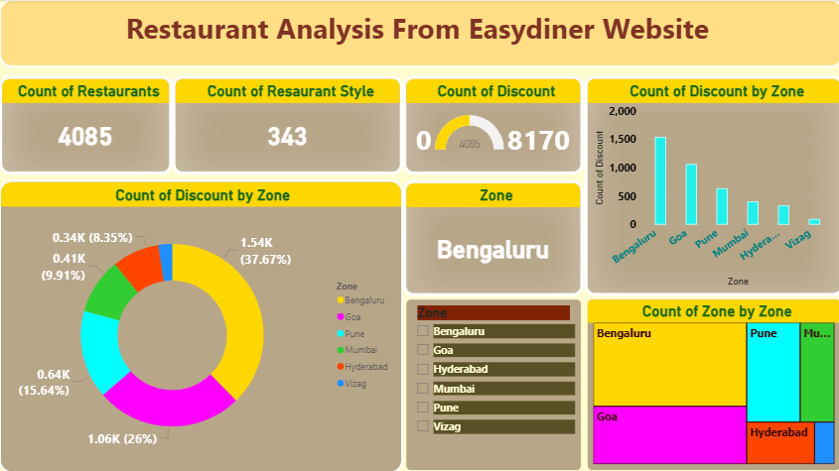
Data Visualization

Slide 13
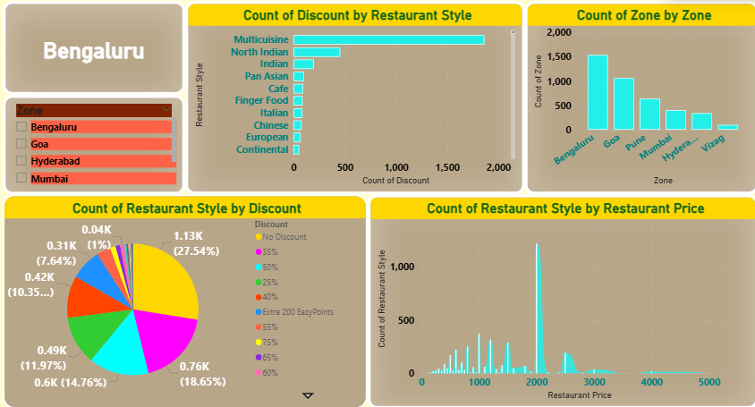
Data Visualization

Slide 14



Summary
“ This project extracts and analyzes restaurant data from Easydiner across seven major Indian cities . After webscraping 4,085 records , the data was cleaned , missing values handled , and explored using Python (Pandas , NumPy , Matplotlib , Seaborn ) . Finally , the dataset was transformed and visualized in Power BI to create interactive dashboards showcasing restaurant styles , prices , discounts , and Zones .”

Slide 15

Thank You For You Attention

